Slide 1
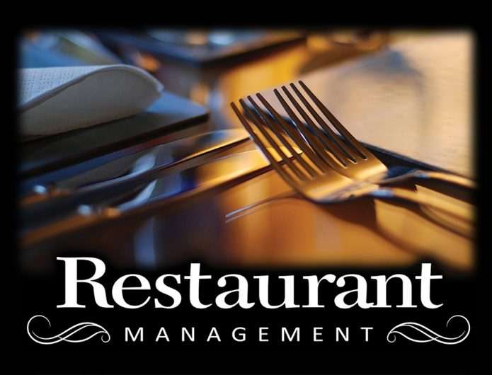

Slide 2
Introduction
This project was conducted in a bid to;
Establish an understanding of the restaurant business
Establish the various long-range trends it has been subjected to.
Establish the challenges experienced in its management

Slide 3
Literature Review
Owners
.Staff
General Manager
Bookkeeper
Asst. Manager
Asst. Manager
Kitchen Manager
Position Staff
Chef
Line cooks
Dishwasher
Pantry
Position Staff
Servers
Hosts
Waitresses
Position Staff
Bar Backs
Bartenders
Cleaners

Slide 4
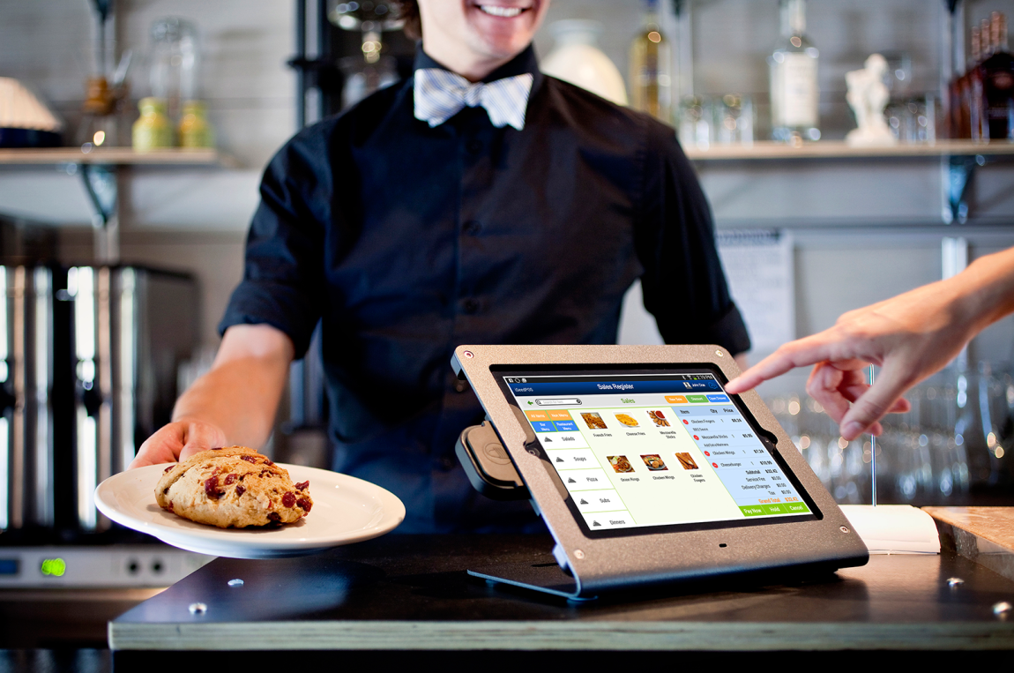
.Point of sale –management of the retail transactions in the restaurants.

Slide 5
Research Funding's
Technology - 95% of restaurateurs agree that restaurant technology improves the business efficiency
Competence and recruitment - 36% of employers cite this as a major challenge as finding staff that will work competently
Uncertainty of the future - The uncertainty of the future makes it difficult for the restaurant managers to engage the strategy management process to ascertain future profitability of their business.

Slide 6
Conclusion
.The restaurant business is a likely business that would change the stake in the market, offer high employment rates than any other business could as it is part of every human livelihood.
.With a growing performance index of 100.4 in September 2017 there are numerous ventures of growth on the restaurant business.

Slide 7
References
Walker, J. R. (2013). The restaurant: from concept to operation. Wiley Global Education.
Han, H., & Hyun, S. S. (2017). Impact of hotel-restaurant image and quality of physical-environment, service, and food on satisfaction and intention. International Journal of Hospitality Management, 63, 82-92.
Giousmpasoglou, C. (2016). Hotel and restaurant management education.
Zheng, C., & Forgacs, G. (2017). The emerging trend of hotel total revenue management. Journal of Revenue and Pricing Management, 16(3), 238-245.
Ruiz-Molina, M. E., Gil-Saura, I., & Berenguer-Contrí, G. (2014). Information and communication technology as a differentiation tool in restaurants. Journal of Foodservice Business Research, 17(5), 410-428.
Silva, J. (2017). U.S. Patent No. 9,805,401. Washington, DC: U.S. Patent and Trademark Office.

